Slide 1

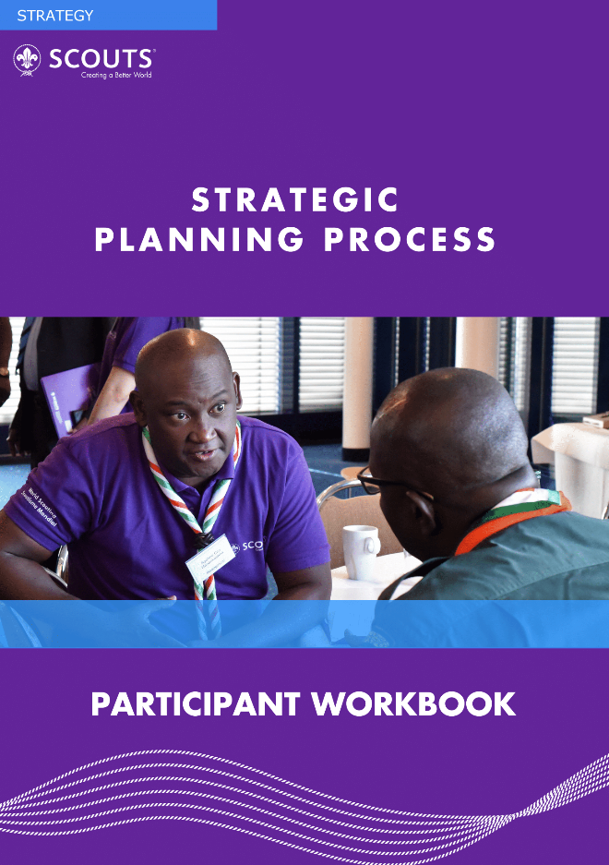
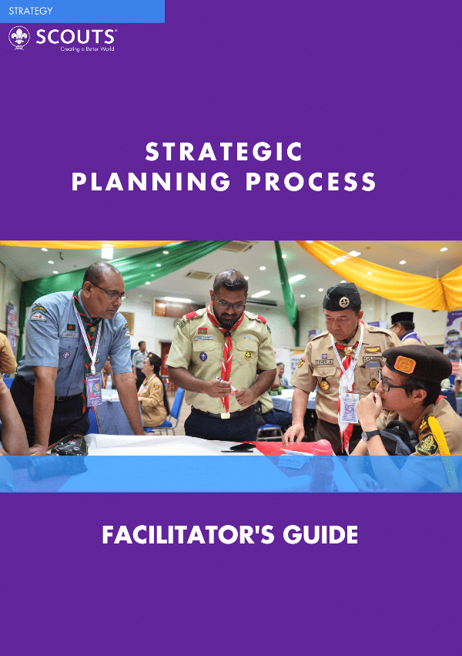
READ ME FIRST (Delete this page before presentation)
This presentation is prepared for the facilitator for the strategic planning process; whether you are running a consultant training or to lead a session in an Association to review your strategy.
Please go through all the slides before you actually run the session, and tailor to your needs. You may delete some of the slides if your session time is short, or you can add more slides.
This presentation is made as part of the Strategic Planning, Monitoring, and Evaluation Toolkit 2023, and it would be most beneficial if you can also use the following documents.

Slide 2


Slide 3
Strategic Planning, Monitoring & Implementation
Your NAME Position, Organisation

Slide 4
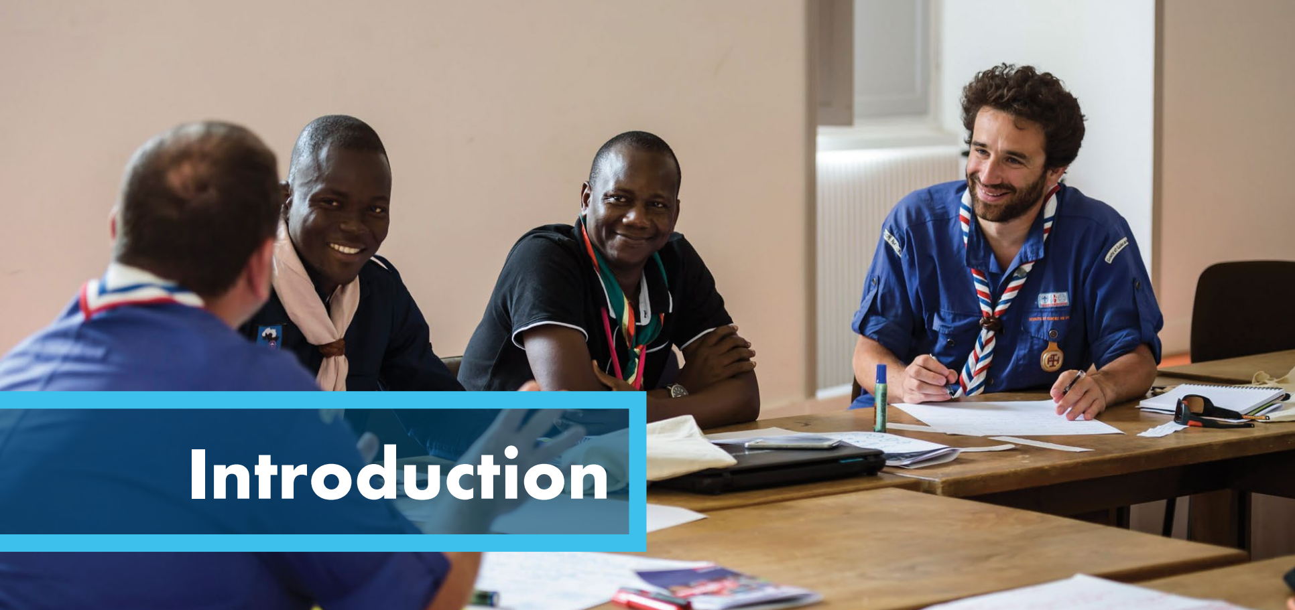

Slide 5
Why strategic planning is necessary?
It forms the direction in which the organisation is heading
It brings everyone in the organisation on the same page, working towards the same vision and goals
It helps prioritize the organisation’s work
It creates synergy across the organisation (cross-team collaboration)
It helps “tell the story” – within and outside of the organisation.

Slide 6
World Scouting’s Mission
Vision 2023
The Mission of Scouting is to contribute to the education of young people, through a value system based on the Scout Promise
and Law, to help build a better world where people are self-fulfilled as individuals and play a constructive role in society.
By 2023 Scouting will be the world’s leading educational youth movement, enabling 100 million young people to be active citizens creating positive change in their communities and in the world based on shared values.

Slide 7




Slide 8
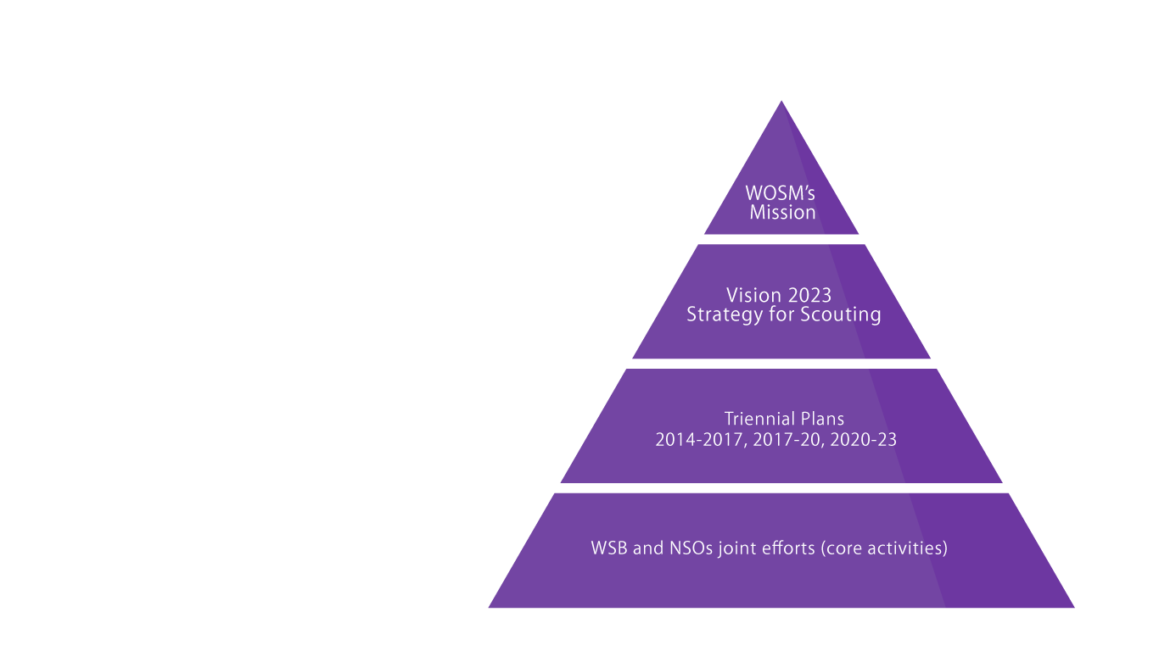
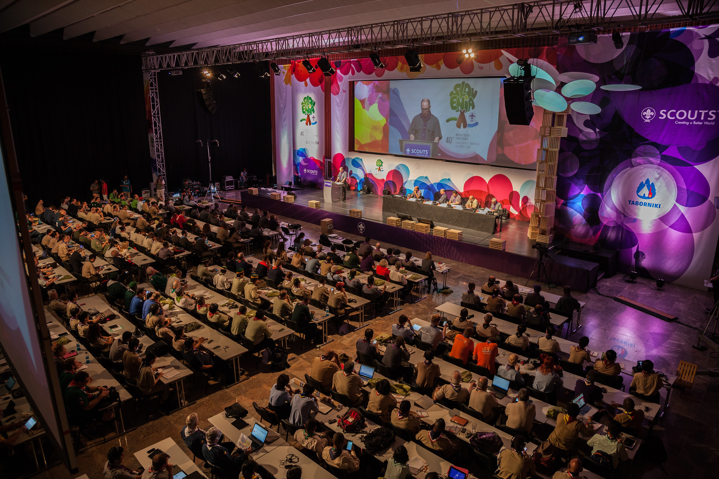
Vision 2023 Strategic Priorities
Youth Engagement
Educational Methods
Diversity and Inclusion
Social Impact
Communications and External Relations
Governance

Slide 9
11 Steps, from planning to evaluation
Step 1: Choosing The Right Time
Step 2: Building The Team
Step 3: Reviewing Your NSO’s Mission And Vision
Step 4: Analysing The Current Situation Of Your NSO
Step 5: Developing Your NSO’s Strategic Plan
Step 6: Aligning Your NSO With The New Strategic Plan
Step 7: Creating An Operational Plan
Step 8: Risk Management Assessment
Step 9: Collecting The Right Monitoring Information
Step 10: Monitoring And Evaluation
Step 11: Reporting On Your NSOs Performance

Slide 10

Choosing the right time
1
The best time to develop a strategic plan is:
Close to completing a current strategic plan
Has a strategic plan in place, however it has not been implemented/ does not correspond to the (future) needs of the organisation
Has never had a strategy
The leadership of the NSO has changed and insists on creating a new strategic plan.
Strategic planning process will take 6-12 months.

Slide 11
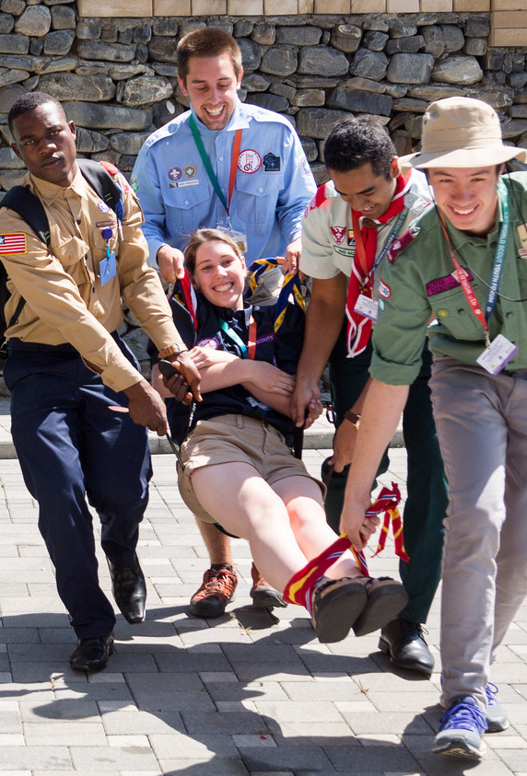
2
Building the team
5 - 7 people, 15 maximum
A good range of volunteers/staff/board members
Strongly understand the organisation
Be well connected with members nationwide
Diversity (particularly young people)
Appoint:
Facilitator/Consultant
Plan-monitor/champion

Slide 12
What is a mission statement?
3
Reviewing mission & vision
WOSM’s mission statement
The overall purpose everyone in the organisation strives towards achieving
“The Mission of Scouting is to contribute to the education of young people, through a value system based on the Scout Promise and Law, to help build a better world where people are self-fulfilled as individuals and play a constructive role in society.”

Slide 13



SAMPLE MISSION STATEMENTS
BOY SCOUTS OF AMERICA: The mission of the Boy Scouts of
America is to prepare young people to make ethical and moral
choices over their lifetimes by instilling in them the values of the
Scout Oath and Law.
BOY SCOUTS OF THE PHILIPPINES: To help the youth develop values and acquire competencies to become responsible citizens and capable leaders anchored on the Scout Oath and Law.
THE KENYA SCOUTS ASSOCIATION: To educate young people to play a constructive role in Society.

Slide 14
What is a Vision statement?
WOSM’s Vision statement
Describes the clear and inspirational long-term desired change resulting from an organisation or program’s work.
Usually lasts around 10 years and should span across several strategic plans.
Ideally specify timeframe, as well as outlining a clear and comprehensible goal for that time period, with a measurable outcome.
“By 2023 Scouting will be the world’s leading educational youth movement, enabling 100 million young people to be active citizens creating positive change in
their communities and in the world based on shared values.”

Slide 15


SAMPLE Vision STATEMENTS
SCOUTS NEW ZEALAND: Our vision is that in 2025, more than 25,000 youth will enjoy scouting adventures. They will come from every background with a place for all, shape their own experiences and make a positive difference for New Zealand.
THE BHARAT SCOUTS AND GUIDES: By 2024, The Bharat Scouts & Guides will be a globally visible, consistently growing, self-reliant premium youth movement that is gender balanced, vibrant and responsive to trends. Providing young people with value-based, attractive and challenging youth programme, through competent leaders, effective communication, optimum use of technology and efficient management.
THE KENYA SCOUTS ASSOCIATION: By 2020, Scouting in Kenya will be the leading youth movement, enabling over 4 million young people to achieve their full potentials as responsible citizens and as members of their local, national and international communities through the Scout Method.

Slide 16

4
Analysing the current situation
GSAT
Competitor analysis
Root cause analysis
Stakeholder analysis
PESTEL analysis
SWOT analysis

Slide 17
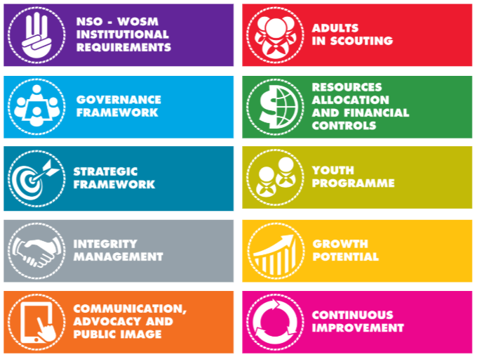
GSAT
Global Support Assessment Tool Launched in 2012
Self-Assessment
Global Support Assesment
GSAT Third Party Assessment
https://www.scout.org/gsat
Notes:
The Global Support Assessment Tool is a Quality Standard owned by WOSM that assesses compliance of NSO towards international best practices in Good Governance and Quality Scouting. The purpose of the GSAT Standard is to serve as a reference of Best Practices for NSOs, and its application will enable NSOs to assess their strengths and weaknesses and, as an outcome, to improve their accountability to stakeholders.
The Global Support Assessment Tool is available in three different ways:
The GSAT Self-Assessment Conducted by the NSO or facilitated by a WOSM volunteer trained as “GSAT Facilitator” appointed by the Regions. This version allows NSOs to use the tool on their own, to evaluate internally the performance of their organisation vis-à-vis international best practices.
The WOSM Global Support Assessment Conducted by a WOSM volunteers trained as “Internal Assessors”, appointed by the Regions and who have been certified under the ISO 19011 Auditing Standard. This version allows a Region to use GSAT to support NSOs that are looking for an external perspective but are not yet ready for a GSAT 3rd Party Assessment.
The GSAT Third party assessment Conducted by SGS (Société Générale de Surveillance), a certification company contracted by WOSM which supported the development of the Quality Standard. This is the original format that was offered at the beginning and for which facilitators were trained. A successful audit, which reaches the pre-defined level of compliance, leads to a certification.
More information can be found at the URL.

Slide 18
Competitor Analysis
Who are our competitors? (Note: keep this broad, i.e. every organisation (NGO or for-profit) that provides educational or leisure time activities for young people, rather than just other youth movements)
What threats do they pose?
What is the profile of our competitors?
What are the objectives of our competitors?
What strategies are our competitors pursuing and how successful are these strategies?
What are the strengths and weaknesses of our competitors?
How are our competitors likely to respond to any changes to the way we do business?

Slide 19
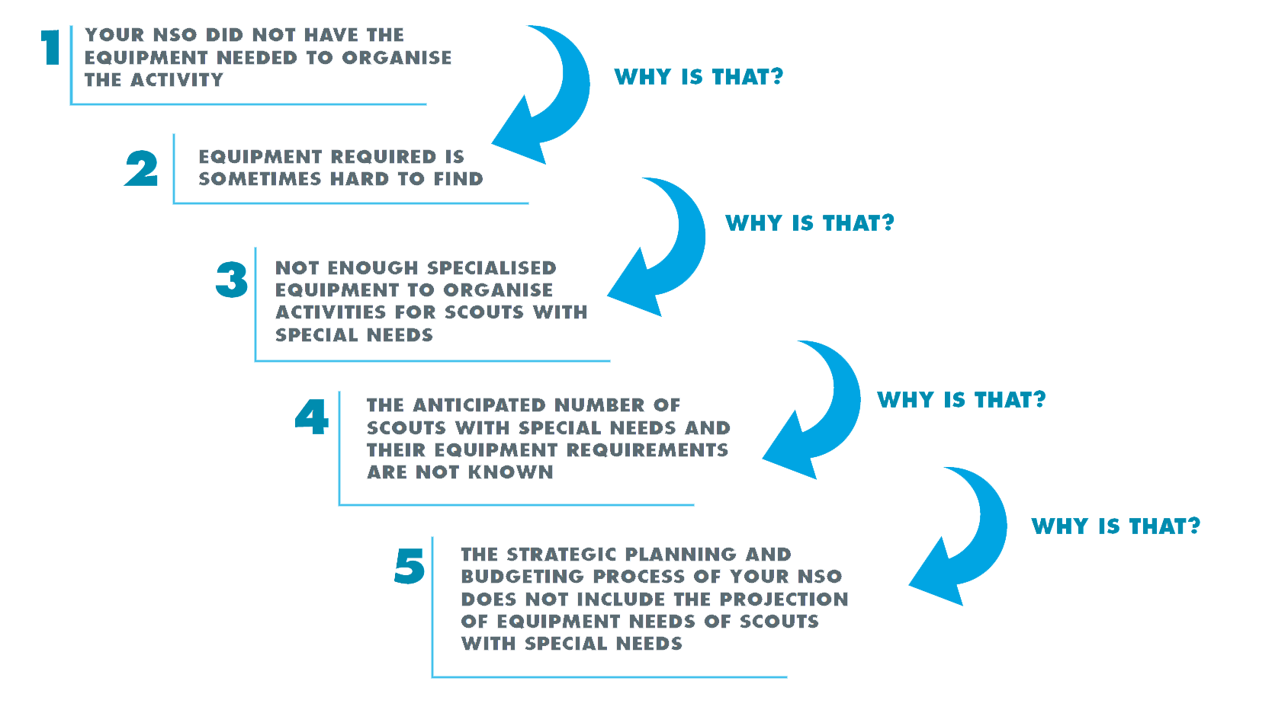
Root Cause Analysis (RCA)
Define the problem
Gather information and data
Find potential causal factors
Identify root causes
Implement solutions
Such questioning is WHY IS THAT?
continued until all the root causes are found. Remember there are three basic types of causes:
Physical, Human, and Organisational.
Notes:
Root Cause Analysis (RCA) is a popular framework to help people to answer the question of why the problem occurred in the first place. RCA tries to analys the origin of the problem by running several steps, often with the associated tools, and identifies 1) What happened; 2)How it happened; 3)Why it happened…so that 4) Actions for preventing reoccurrence are developed.
In the step, (1) first you need to set a one key problem you want to analyse.
(2) Then list the proof of the problems by data, and then (3) need to identify all issues and events that contributed to the problem.
(4) Repeat the process until you cannot break things down.
(5) After you came down to the root cause, then what you should do is identify recommendations for eliminating or mitigating the reoccurrence of problems or events.

Slide 20
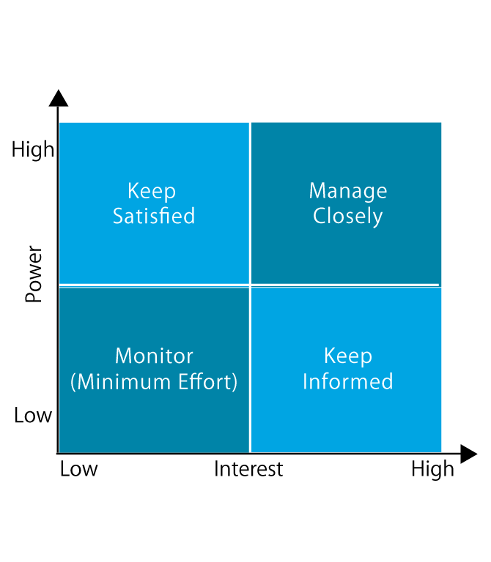
Stakeholder Analyses
Brainstorm and identify groups of people, organisations, institutions who have an interest in your organisation, and who can impact the organisation.
Analyse and clarify them into the chart, and identify 4 -6 key stakeholders.
Notes:
Root Cause Analysis (RCA) is a popular framework to help people to answer the question of why the problem occurred in the first place. RCA tries to analys the origin of the problem by running several steps, often with the associated tools, and identifies 1) What happened; 2)How it happened; 3)Why it happened…so that 4) Actions for preventing reoccurrence are developed.
In the step, (1) first you need to set a one key problem you want to analyse.
(2) Then list the proof of the problems by data, and then (3) need to identify all issues and events that contributed to the problem.
(4) Repeat the process until you cannot break things down.
(5) After you came down to the root cause, then what you should do is identify recommendations for eliminating or mitigating the reoccurrence of problems or events.

Slide 21
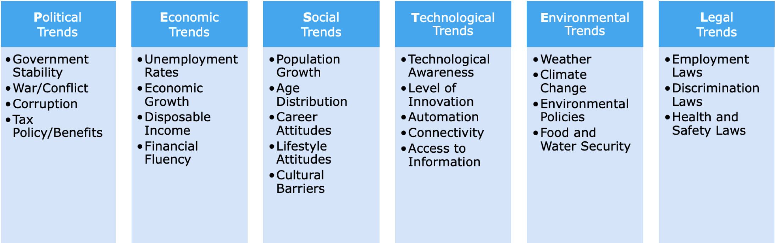
PESTEL Analysis
External trends analysis to identify threats and opportunities

Slide 22
SWOT analysis
Helpful tool to examine all potential factors related to the organisation
Use this tool after conducting previous analytical tools mentioned
Stakeholder analysis will feed largely into the Strengths and Weaknesses boxes
PESTEL analysis will feed largely into the Opportunities and Threats boxes.
Internal | Strengths | Weaknesses
External | Opportunities | Threats
Notes:
use a SWOT analysis to capture, consolidate and present all the data you have gathered so far.

Slide 23
5
Strategic Plan development
Review Mission & Vision, and the Strategic Analysis
Identify 4-6 strategic priorities
Review WOSM’s strategic priorities
Write an objective for each item
Come up with actions for each objective
You may include more info (value, success measures)
Consult with your stakeholders
Use WOSM Priorities and other NSOs example
Notes:
Firstly, confirm or write the NSO’s mission and vision statements.
Then, identify 4-6 strategic priorities for the organisation in order to achieve the vision statement you have set. Do this by reviewing the SWOT analysis and identifying the common themes – think broad and not detailed (some examples might be membership growth, governance, youth involvement, programme, volunteers, communication or operations).
Review WOSM’s strategic priorities and see if they align with yours
Write an objective for each one based on what issue was identified in the SWOT analysis. Then, write any suggested actions that will help reach that objective.
Some NSOs include a lot more information on each of the strategic priorities in their plans. Consider including other things like your organisation’s values, or success measures, into your plan.
Include regular consultation with your stakeholders throughout this process to sense check your progress.

Slide 24
World Scouting’s Example
Adults in Scouting
Strengthen the implementation of all aspects of the life cycle of Adults in Scouting (including recruitment, training and retention), in accordance with the World Adults in Scouting (AiS) Policy.
KPI: 80 NSOs will improve their internal processes for recruiting, training and retaining adult leaders, in accordance with the World AiS policy.
Ensure the safety of Scouts from harm.
KPI: 35 additional NSOs will incorporate a Safe from Harm policy in their national policies and practices, inspired by the WOSM Safe from Harm policy.
Strategic Priorities
Youth Engagement
Educational Methods
Diversity and Inclusion
Social Impact
Communications and External Relations
Governance
Educational Methods
Youth Programme
Adults in Scouting
World Events
Diversity and Inclusion

Slide 25
6
Strategic Plan Alignment
Adopt
Formal approval and adoption e.g. by your General Assembly.
Launch
Communicate to your members - Why - How - What
Implement
Everything towards achieving the goals - Structures - People - Projects - Activities

Slide 26
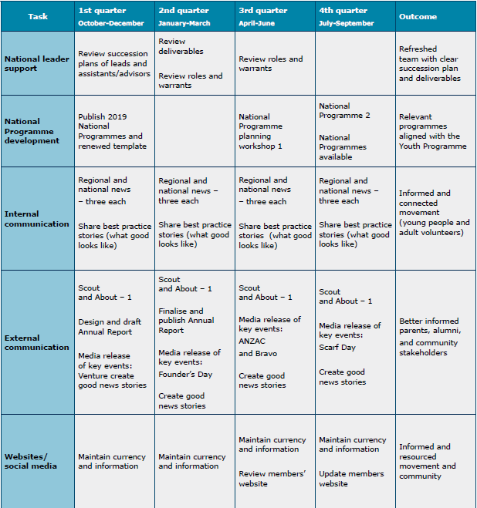
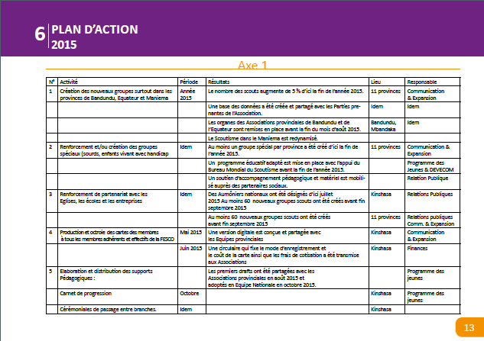
7
Creating an Operational Plan
The operational plan outlines the:
Activities your NSO plans to conduct to achieve your vision
Time and place where they will be conducted
Person (or team) responsible for the completion of each activity
KPIs for knowing how you are doing against your strategic plan (Please refer to Step 9)
See Toolkit P.47-51 for some examples

Slide 27
8
Risk Management Assessment
Identify the steps/places in the process where things might go wrong
Describe some of the potential “failures”
Describe the impact of those “failures” on your organisation’s work and achieving your strategic plan
What caused these “failures”?
How much warning time do you have before these “failures” potentially occur (i.e. how much in advance is it possible to predict these “failures” happening)?
What solutions can you come up with to mitigate or fix these “failures”?

Slide 28
FMEA (Failure Mode Effect Analysis)
Risk Description | Impact | Likelihood | Total score | Accountability/ review frequency
Fall in interest among youth members for programme | 4 | 3 | 7 | Youth Programme team/annually
Low retention rates with adult volunteers | 4 | 2 | 6 | Adults in Scouting team/annually
Lack of financial resources for activities | 3 | 2 | 5 | Chief executive/biannually
Competition offering similar activities | 2 | 2 | 4 | Chief exec and communications team/quarterly

Slide 29
Why need to measure?
9
Collecting the Right Monitoring Information
What/How you measure?
Ensuring conformity control (data for leadership)
To external audiences (e.g. donors)
Draw attention of external audiences
Constant learning
Numbers/quantitative
hours of service
amount of financial resources spent
numbers of participants
Non-numeric/qualitative
social impact

Slide 30
Design Key Performance Questions (KPQs)
Choose one to three KPQs per strategic priority
Performance related
Create short and clear questions
Should be open-ended questions
Focus on the present and future
Engage people in the creation of the questions
They should be refined and improved along the way
They should form the basis of developing your KPIs
Use KPQs to report and communicate progress

Slide 31
KPQ Examples
How well are we delivering our new Youth Programme?
How likely are our members to recommend Scouting to their friends?
How do our local communities see Scouting?
How well are we performing in developing partnerships with other NGOs?
How effective is our new communications strategy?
To what extent are we reaching out to marginalised communities in our country?
To what extent have we improved our decision-making processes on national level?
To what extent are we collaborating between units?
To what extent are we impacting the lives of others in the local communities where Scouting exists?

Slide 32
Designing Key Performance Indicators (KPIs)
KPI checklist
Do we have a KPQ to which this indicator is associated?
Are there decisions this indicator would support?
Can we collect meaningful data for this indicator?
Does this indicator help us to answer our KPQ?
Does this indicator help us to make better decisions?
Are the assessment costs and efforts justified?
KPIs is to collect information that
will ultimately help us in:
learning about the status of progress we’re making towards achieving our strategy, and based on this knowledge
making well-informed decisions that will lead towards improvement and better performance in our organisation

Slide 33
KPI/KPQ example
KPI | Strategic priority it corresponds to | KPQ it helps answer | Data collection method/frequency of collection | Person/team responsible for collection
By 2023, our Association will have increased membership in marginalised communities by 10%. | Membership Growth | How well are we reaching out to marginalised communities? | Census data from our local units/annual basis. | Membership Growth Task Force.
By 2023, 90% of our units will be implementing our new Youth Programme, that has a strong focus on catering for diverse needs of our members. | Membership Diversity | To what extend are we delivering a programme that caters for the diverse needs of our membership? | Annual survey with local unit leaders/biannual basis. | Youth Programme Team.

Slide 34
10
Monitoring and Evaluation
 | Monitoring | Evaluation
Timeline | Continual collection of information, throughout programme/project | Periodic review at a significant point in the project. End of project, Mid-term and Change of Phase
Focus | Measures activity (Outputs) | Evaluates success (Outcomes)
Purpose | Progress tracker Asks whether the project is being implemented as planned – are we on the right track | Reflection and correction – Asks whether the activities (outputs) have resulted in achieving the objectives (outcomes) and contributed to the goal Whether the project is successful
Stakeholders | Often uses people inside the project | Uses a mix of people from inside and outside the project, including those who (should) have been impacted by the project
Results | May result in minor action to correct the situation | May result in major strategy change

Slide 35
11
Reporting on your performance
Appoint a Plan Monitor/Champion
A strategic planning committee member
Report to the membership and the board in regular basis
Need to work closely with the leadership, committees, task forces
Develop reporting framework
Celebrate and showcase the success
Performance driven culture

Slide 36
11 Steps, from planning to evaluation
Step 1: Choosing The Right Time
Step 2: Building The Team
Step 3: Reviewing Your NSO’s Mission And Vision
Step 4: Analysing The Current Situation Of Your NSO
Step 5: Developing Your NSO’s Strategic Plan
Step 6: Aligning Your NSO With The New Strategic Plan
Step 7: Creating An Operational Plan
Step 8: Risk Management Assessment
Step 9: Collecting The Right Monitoring Information
Step 10: Monitoring And Evaluation
Step 11: Reporting On Your NSOs Performance

Slide 37
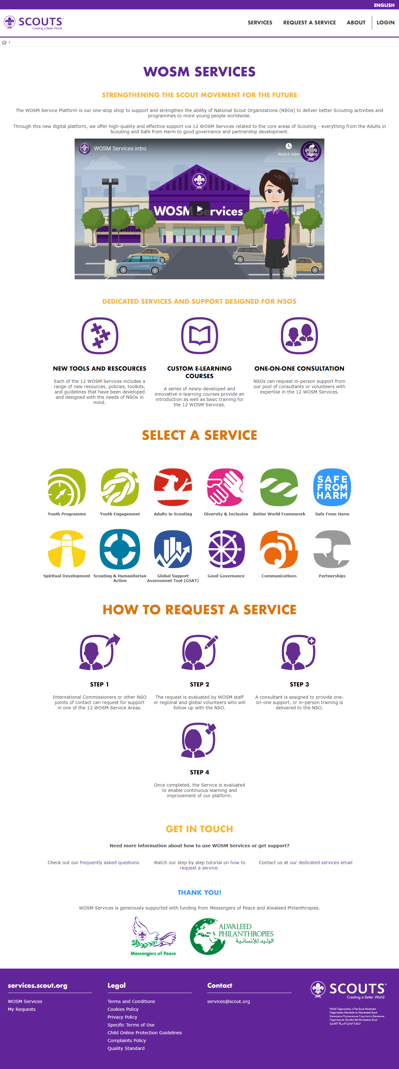
Resources
scout.org https://services.scout.org/about
Toolkit
NSO Examples
Participant Workbook
Facilitator’s Guide
E-learning module
PowerPoint
Videos
One pager resources
Infographic
Templates

Slide 38
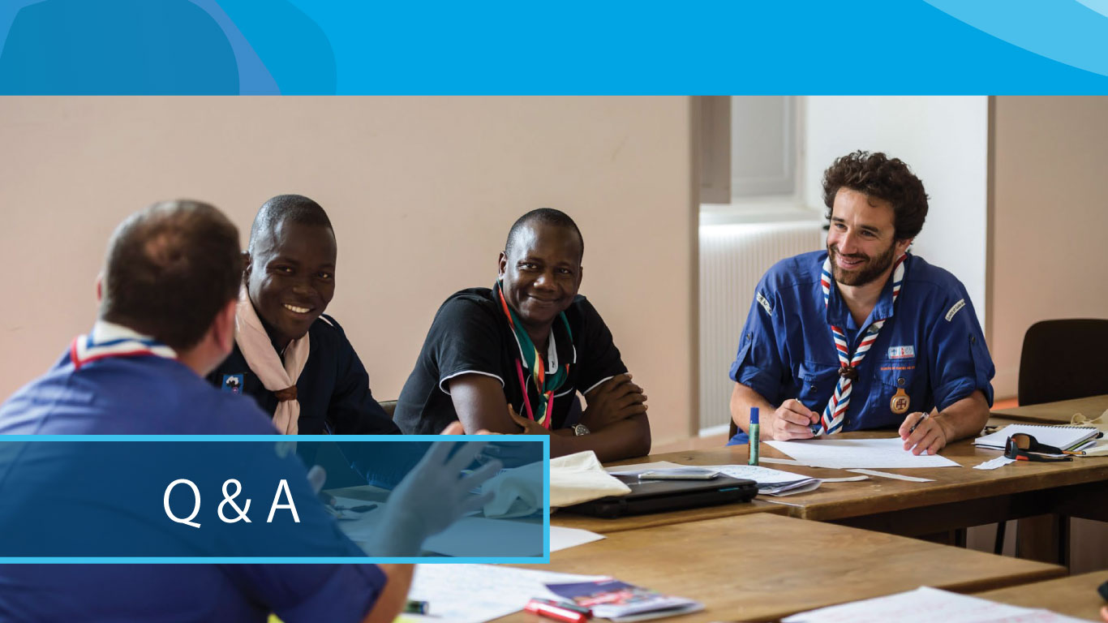

Slide 39
Thank you

